Slide 1
UNIX-Programming BASH
Unit-05

Slide 2
Unix programming and shell scripting like Bash are important for their ability to automate tasks, process text, ensure portability, offer customization, and manage system resources efficiently. These capabilities are essential for system administrators, developers, and anyone working with Unix-like operating systems.

Slide 3
Automation of Repetitive Tasks: With shell scripts, you can automate tasks such as file management, system monitoring, and batch processing, which saves time and reduces the potential for human error.
Powerful Text Processing Tools: Unix provides a suite of powerful text processing tools like grep, awk, and sed, which are indispensable for working with text data, logs, and configuration files. These tools allow for complex data manipulation and analysis, making it easier to extract, transform, and process data efficiently.
Portability and Compatibility: Unix scripts can be run on any Unix-like operating systems, such as Linux, macOS, and BSD variants, without the need for modification.
Customization and Control: Unix programming offers a high degree of customization and control over the system. Users can write scripts to modify their environment, manage system services, and configure system settings to their liking. This level of control allows users to optimize their workflows and system performance.

Slide 4
Foundation for Many Modern Technologies: Unix-like operating systems are the foundation for many modern technologies, including web servers, cloud computing, and mobile devices. Understanding Unix programming is essential for working with these technologies, as it provides the knowledge to manage and interact with the underlying systems effectively.
Efficient Resource Management: Unix programming allows users to directly manage system resources, such as processes and memory, through the command line. This direct access facilitates efficient resource management, enabling users to monitor and optimize system performance.
Scripting for Development and Deployment: For software developers, Unix scripting is crucial for automating development and deployment processes. Scripts can be used to automate code compilation, testing, and deployment, making the software development lifecycle more efficient.
Learning Unix Philosophy: The Unix philosophy emphasizes building simple, modular programs that do one thing well and can be combined to perform complex tasks. Learning Unix programming instills this philosophy, encouraging the creation of efficient, reusable code.

Slide 5
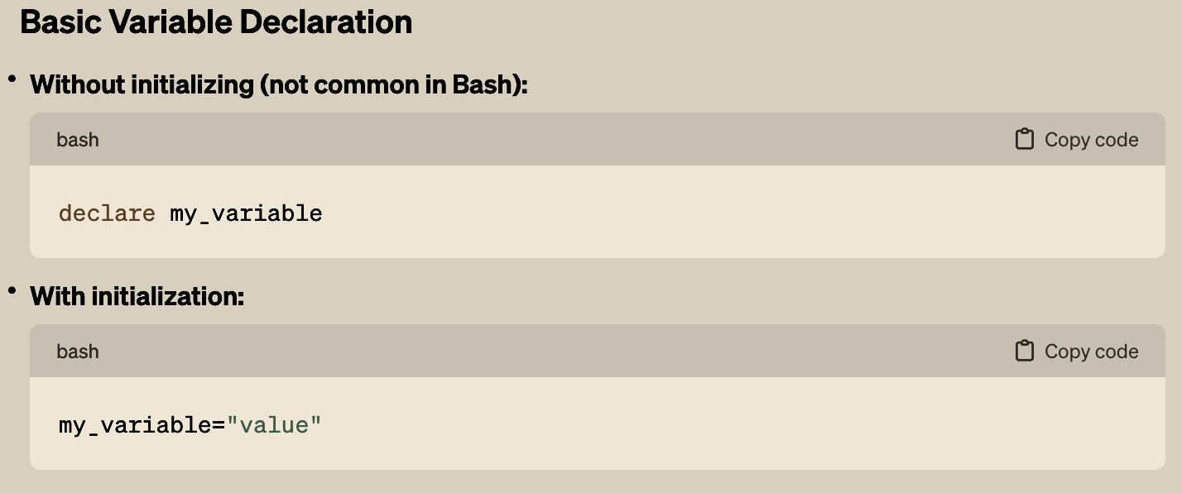
BASICS: Declaring Variable

Slide 6
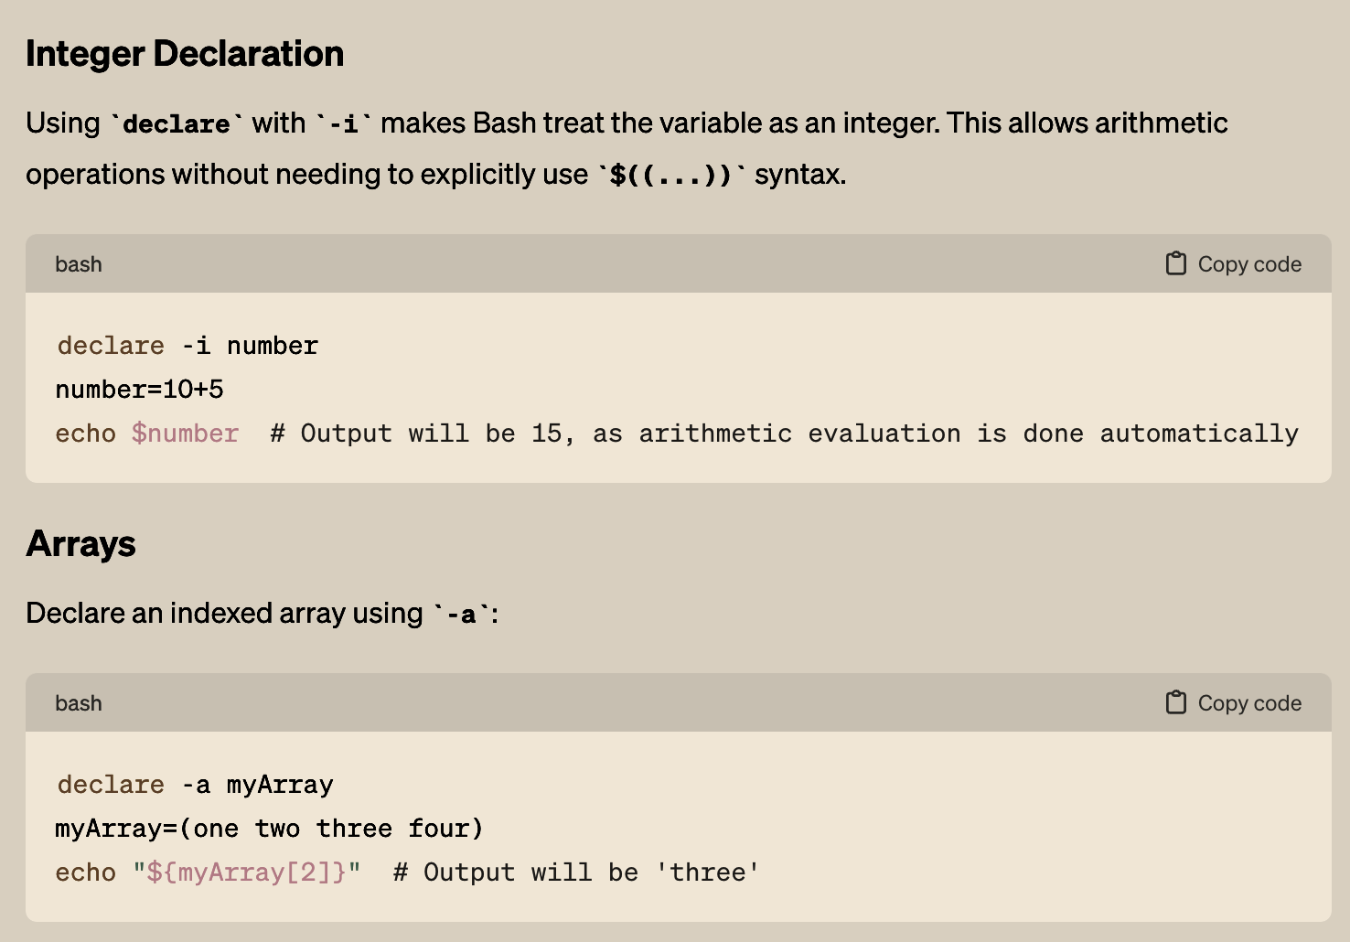
BASICS: Declaring Variable

Slide 7
BASICS: Declaring Variable

Slide 8
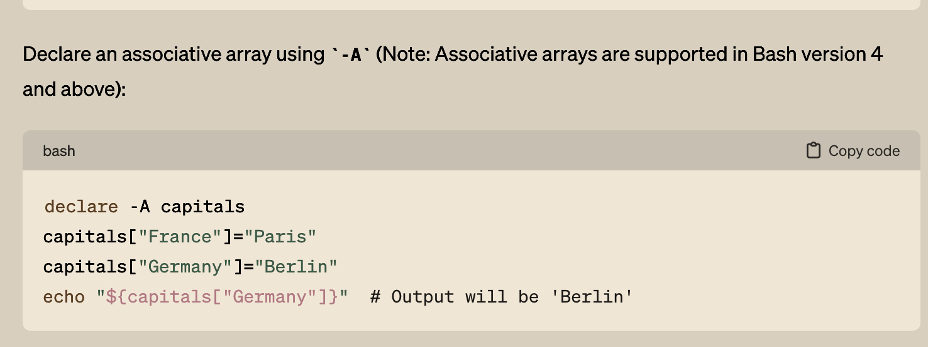
BASICS: Declaring Variable

Slide 9
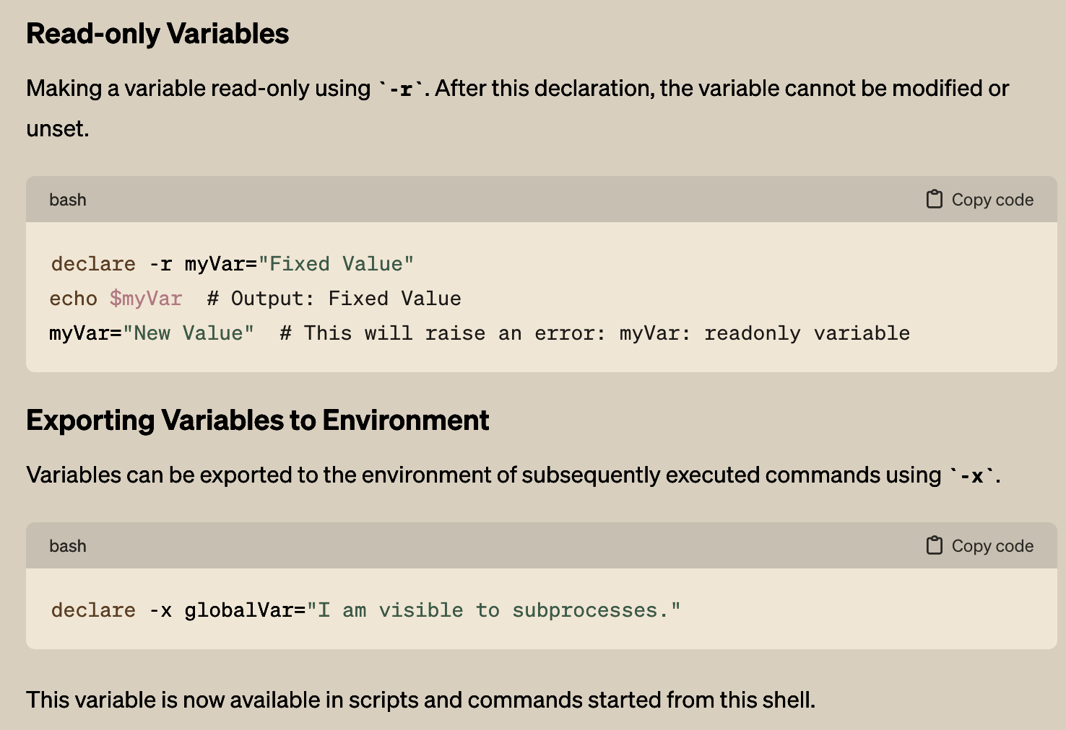
BASICS: Declaring Variable

Slide 10
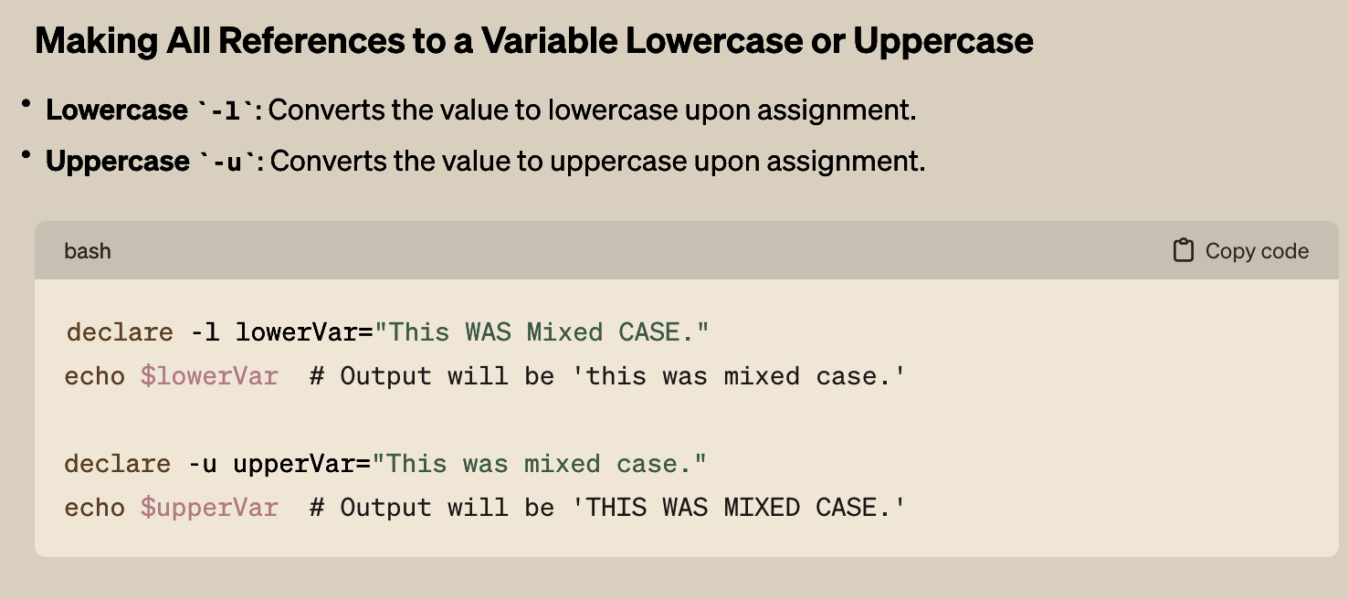
BASICS: Declaring Variable

Slide 11
BASICS: Declaring Variable
What happens if we run following without declaring?

Slide 12
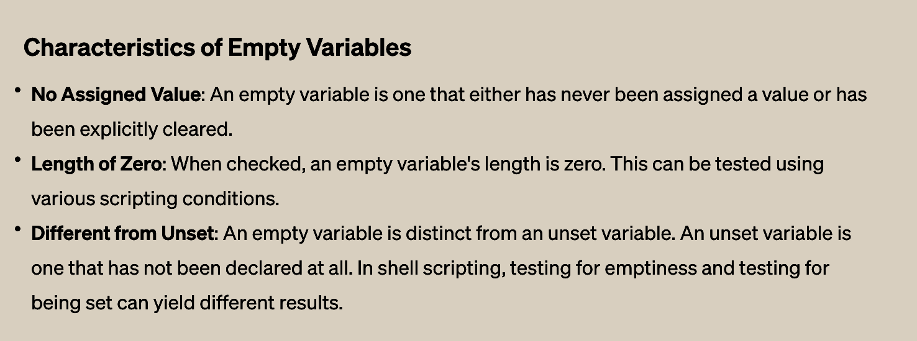
BASICS: Declaring Variable
set/unset vs empty variable

Slide 13
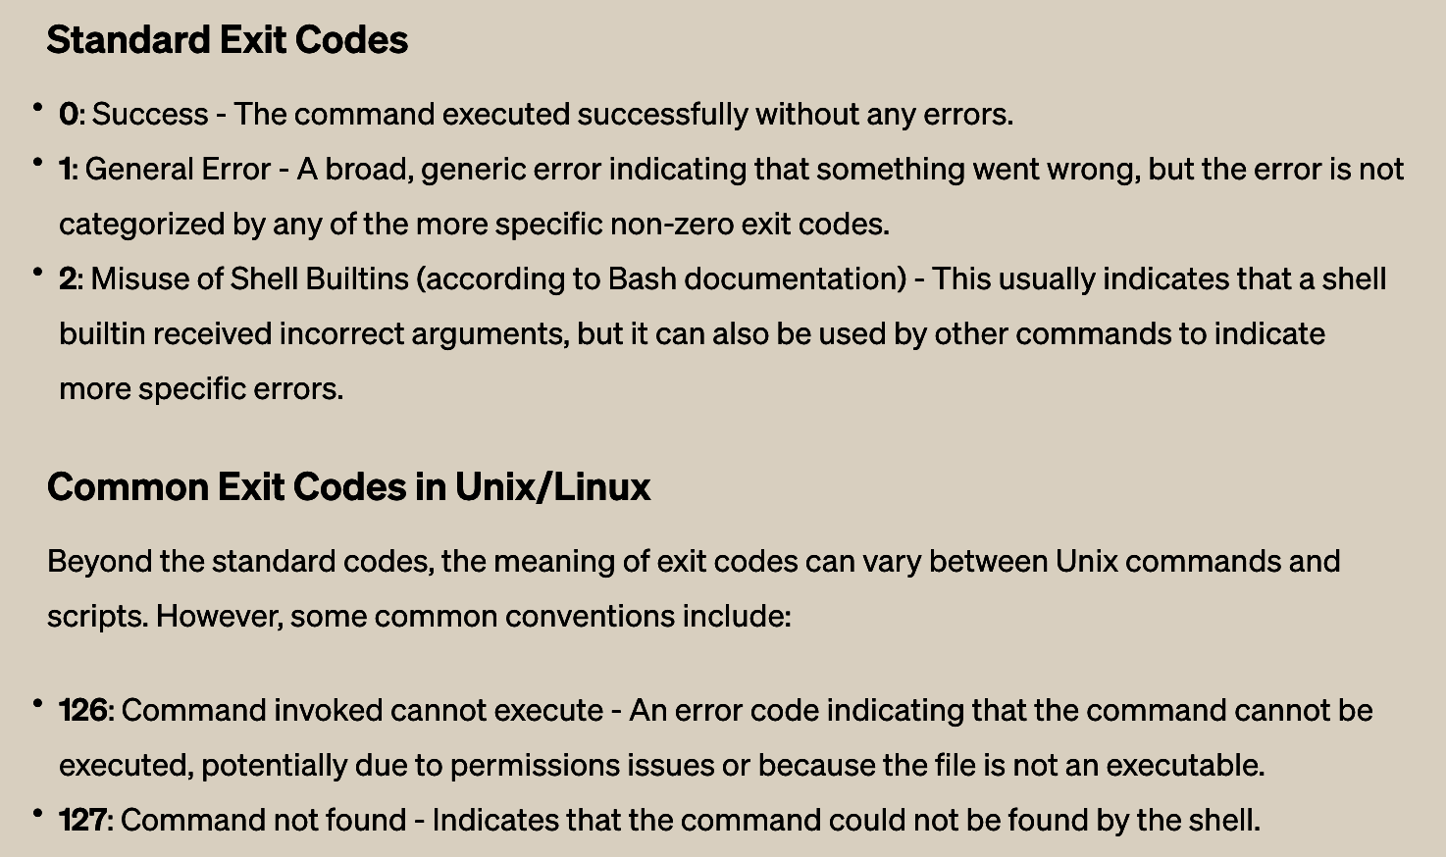
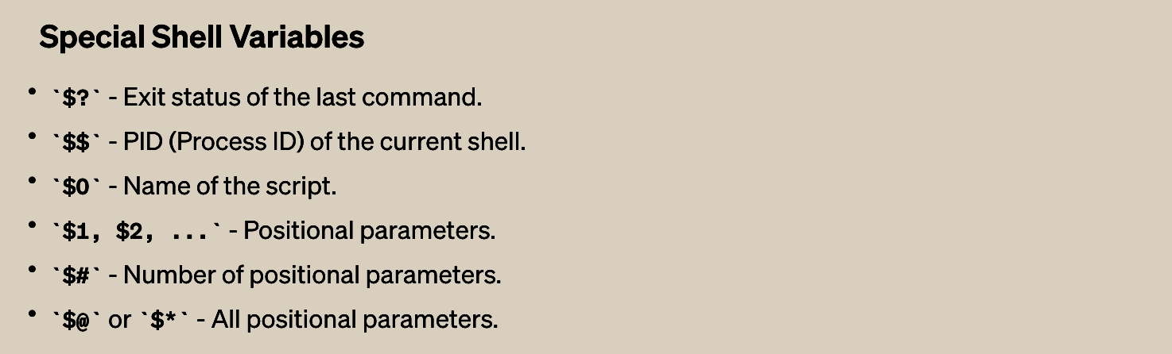
BASICS: Special Variables

Slide 14
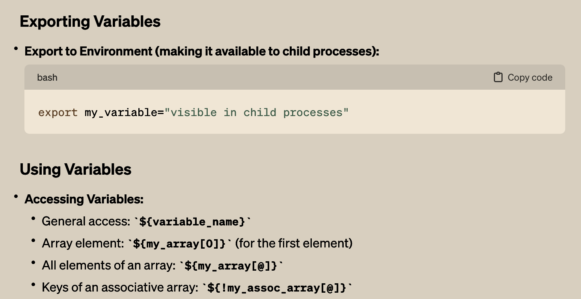
BASICS: Using and exporting Variables

Slide 15
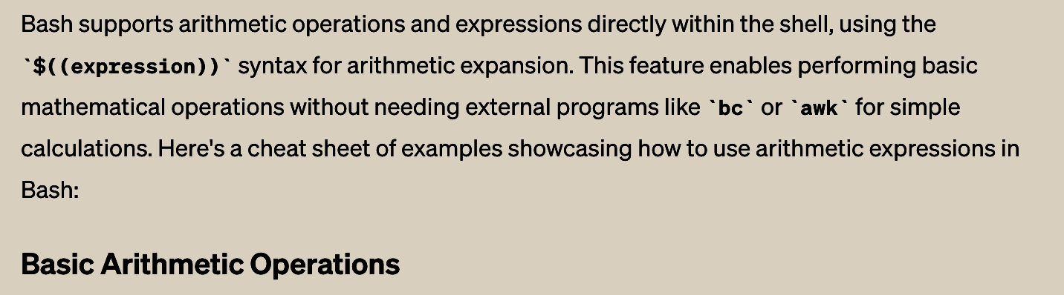
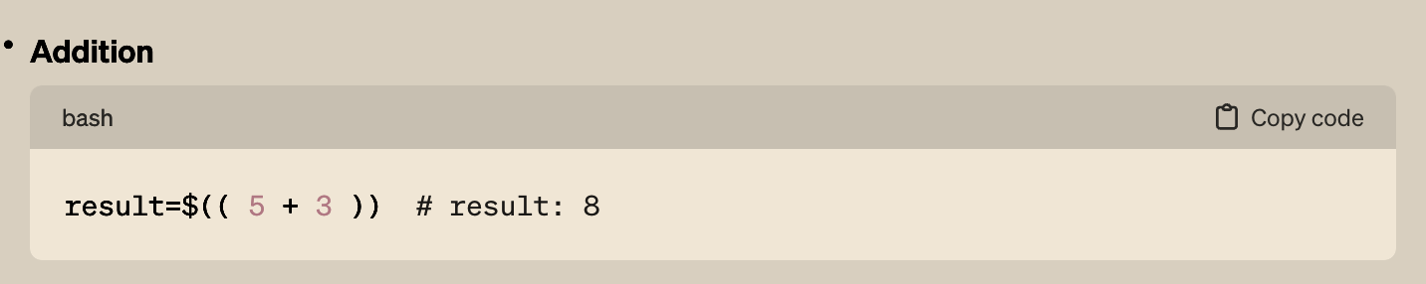
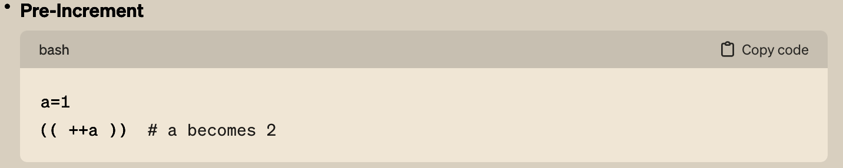
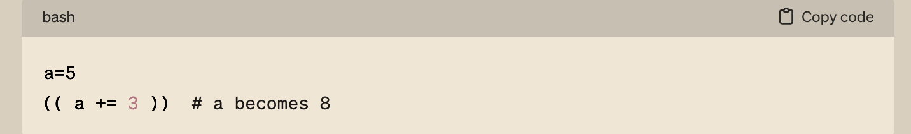
BASICS: Expressions Examples

Slide 16
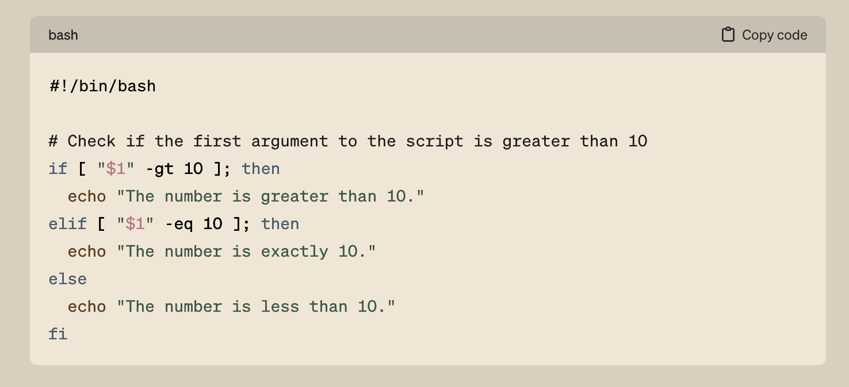
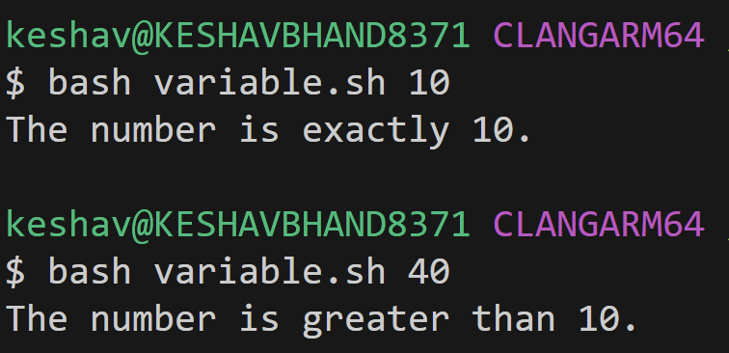
BASICS: Conditionals

Slide 17
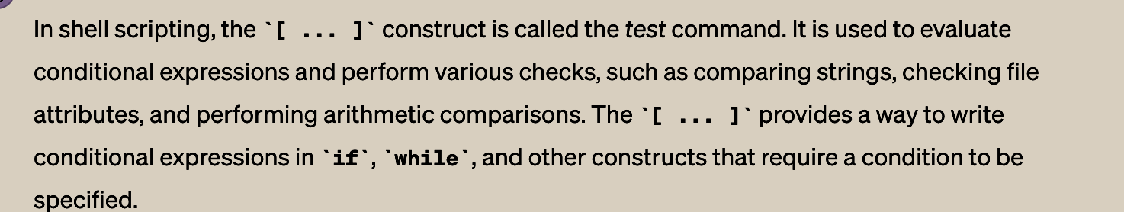
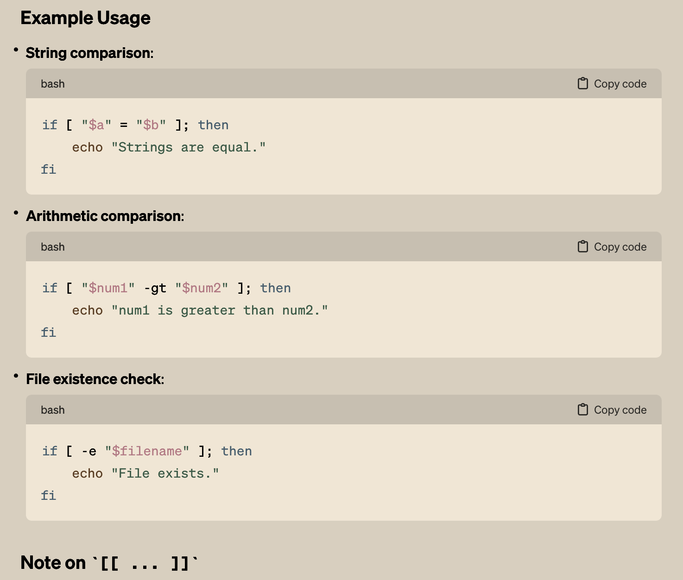
BASICS: Test Commands

Slide 18
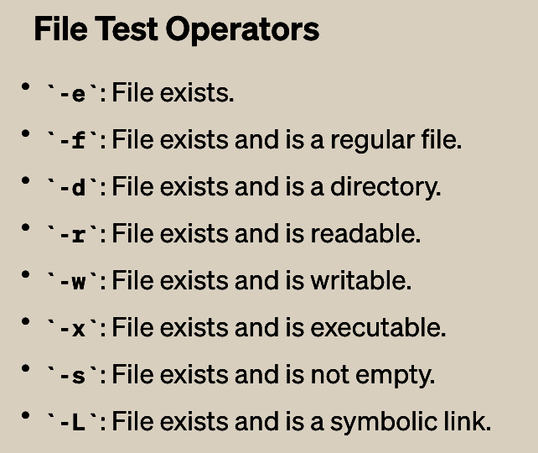
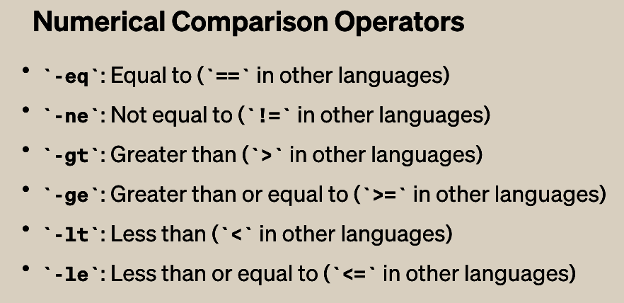
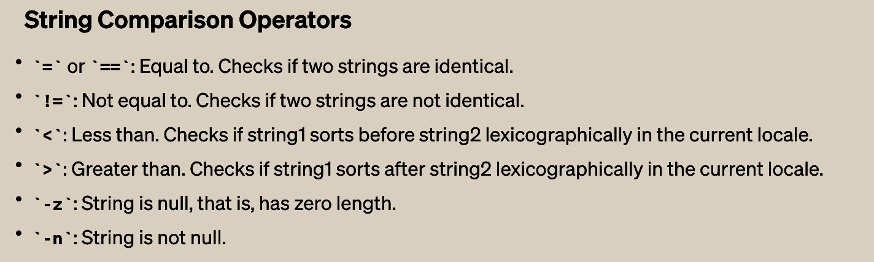
BASICS: Comparison Operations

Slide 19
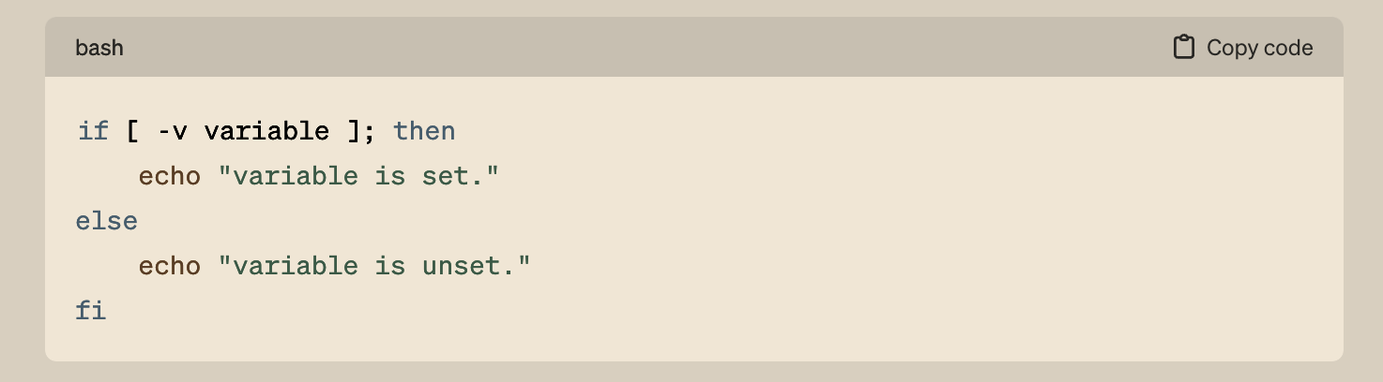
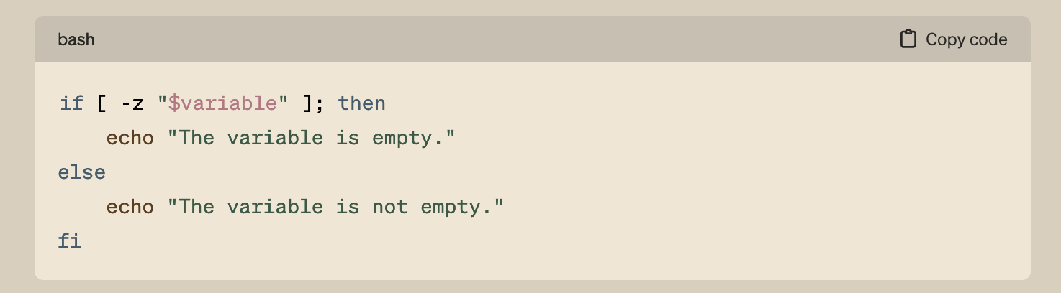
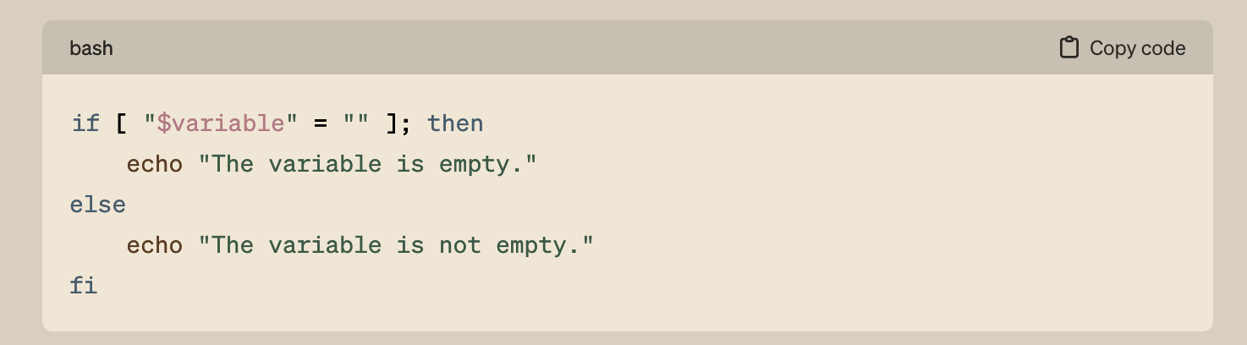
BASICS: Conditionals | more examples

Slide 20
BASICS: Conditionals | more examples

Slide 21
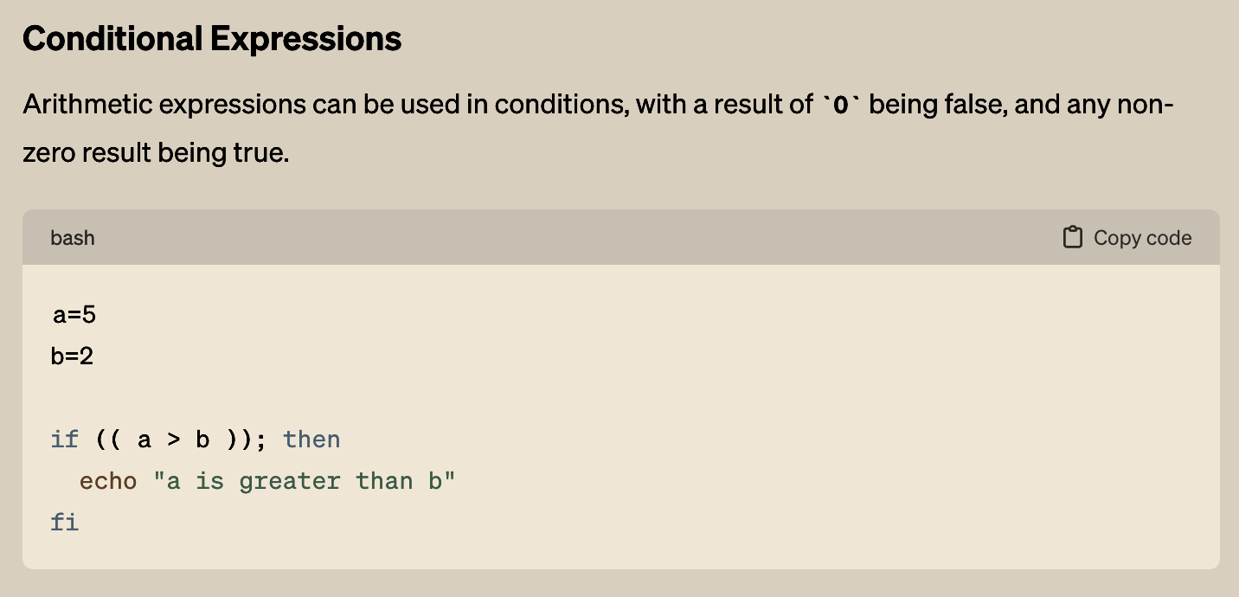
BASICS: Conditionals | more examples

Slide 22
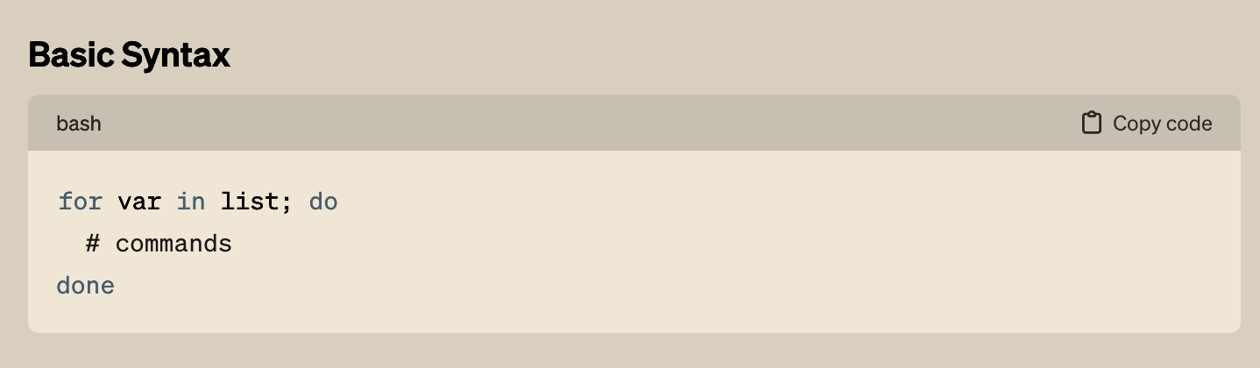
BASICS: For Loop

Slide 23
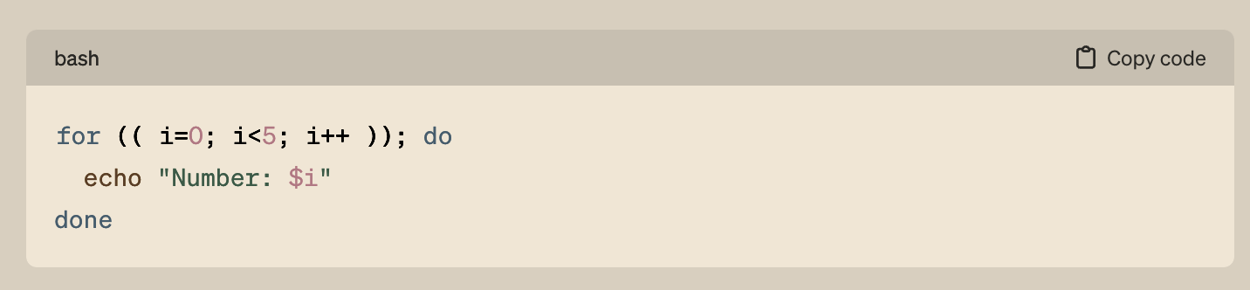
BASICS: For Loop

Slide 24
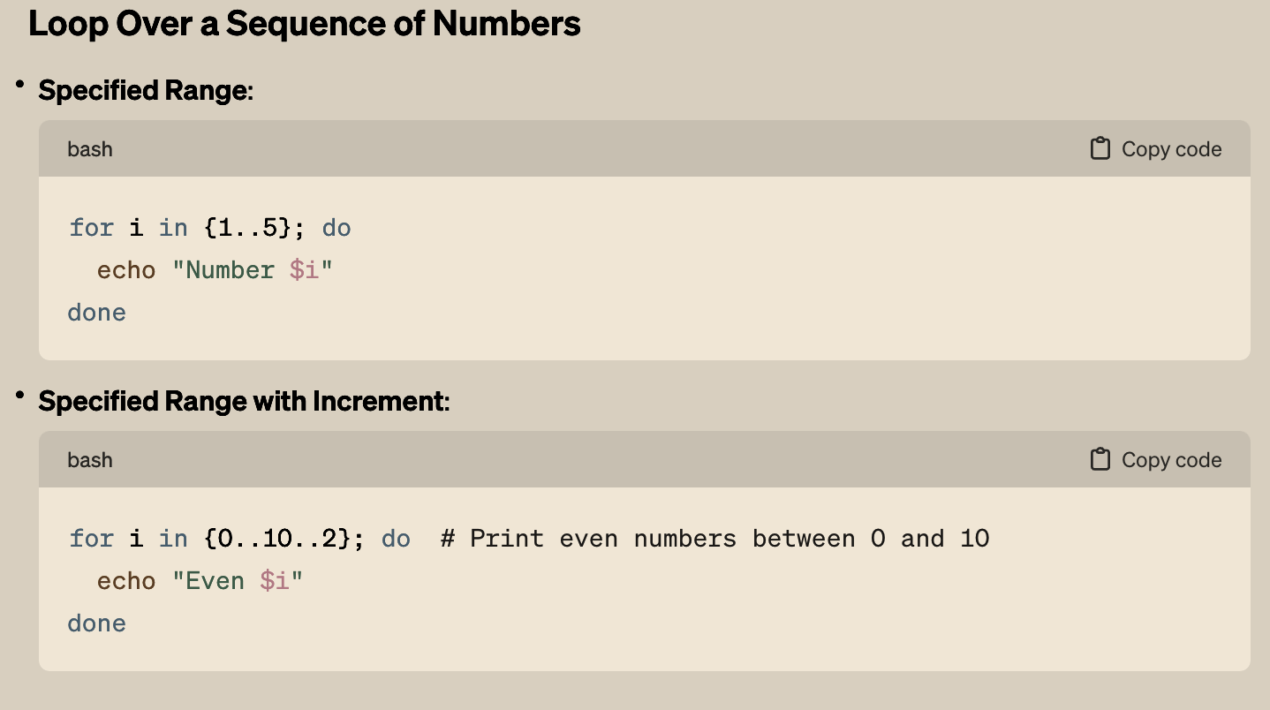
BASICS: For Loop

Slide 25
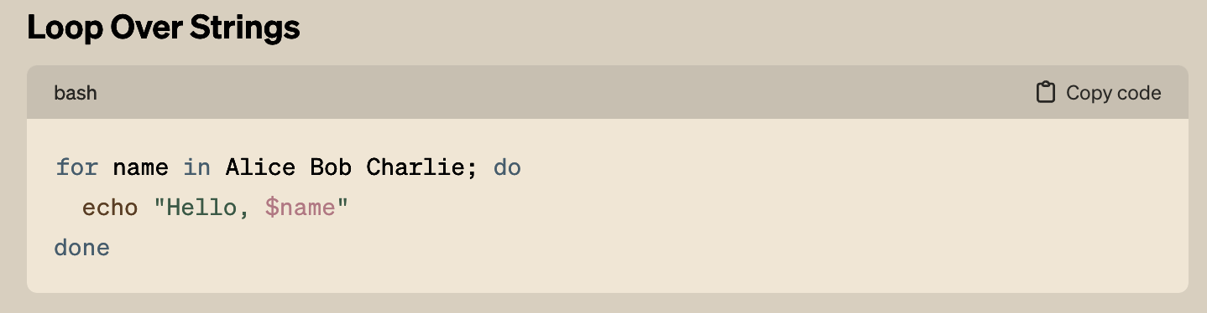
BASICS: For Loop

Slide 26
BASICS: For Loop

Slide 27
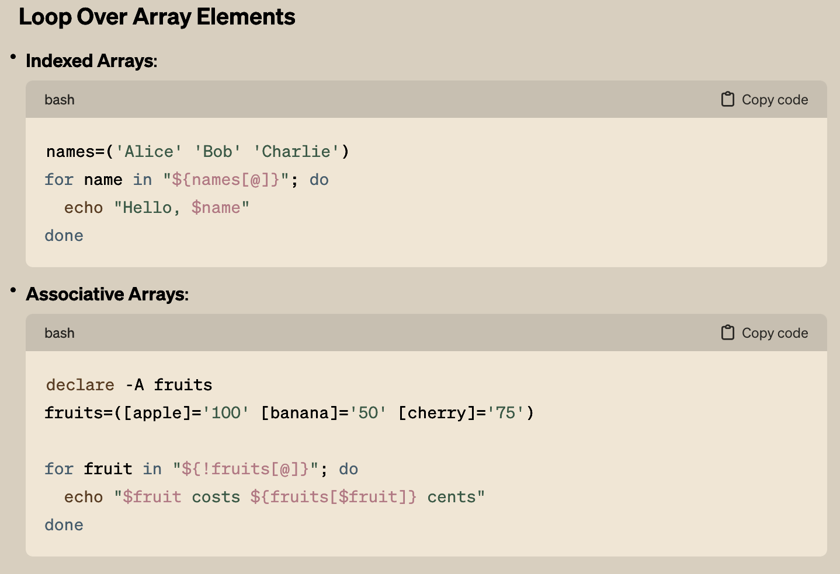
BASICS: For Loop

Slide 28
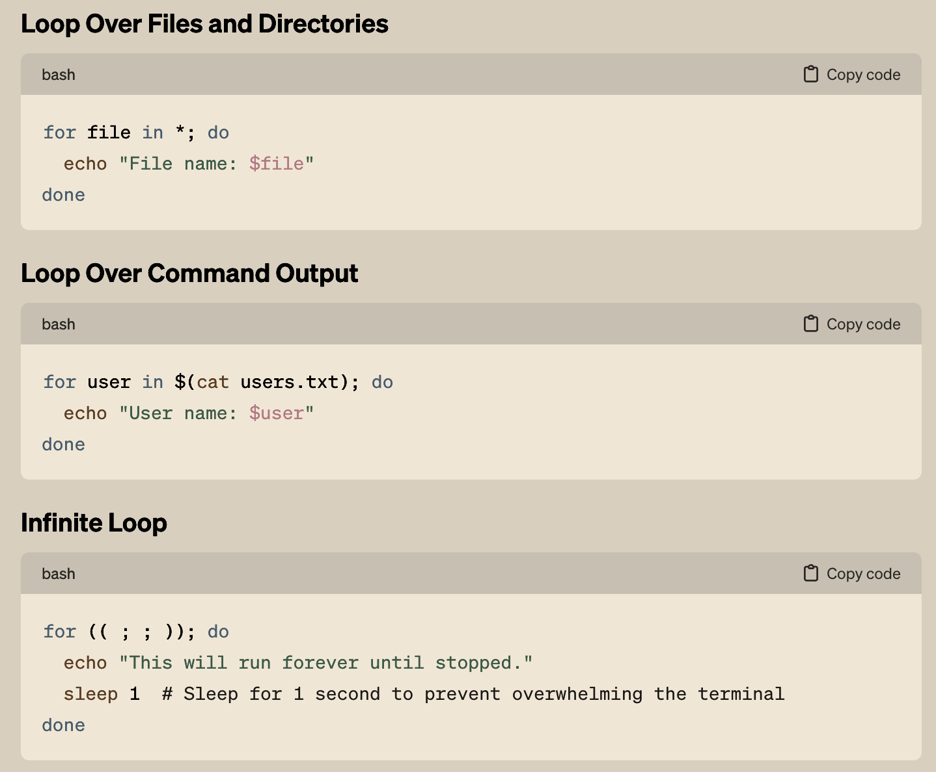
BASICS: For Loop

Slide 29
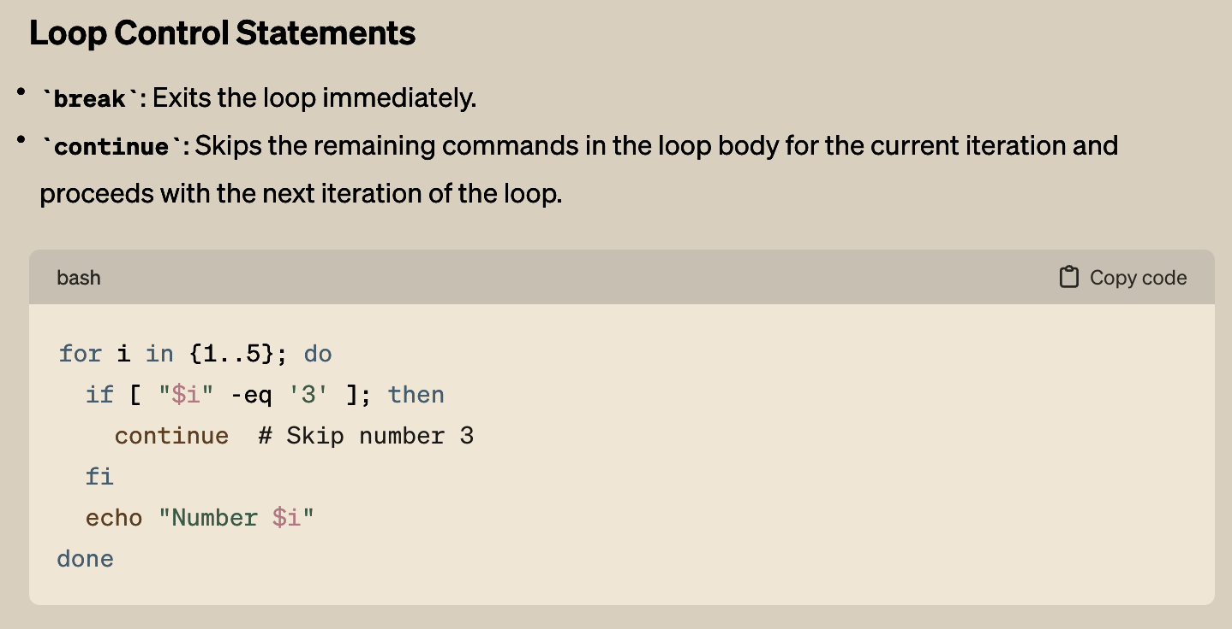
BASICS: For Loop

Slide 30
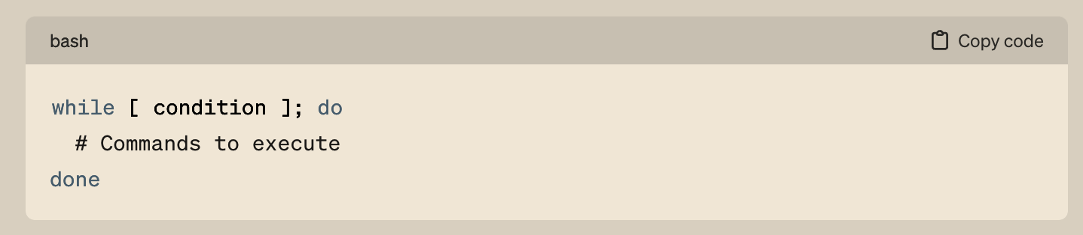
BASICS: While Loop

Slide 31
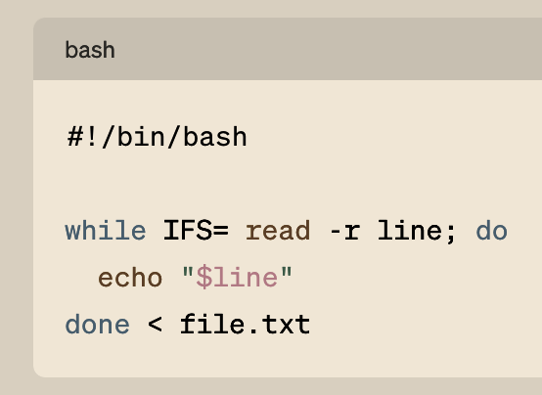
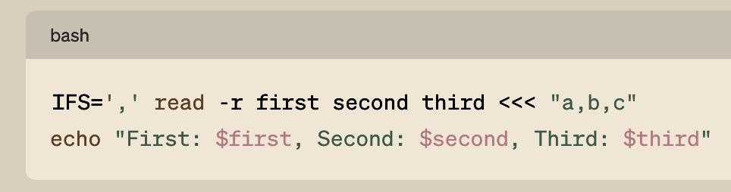
BASICS: while-loop: Reading File examples
#!/bin/bash: This is known as a shebang or hashbang. It specifies the path to the Bash interpreter that should be used to execute the script. This line tells the operating system to run this script with /bin/bash, ensuring it's interpreted as a Bash script regardless of the executing shell.
IFS=: This temporarily sets the Internal Field Separator (IFS) to an empty value for the read command.
read -r line: This command reads input from standard input (stdin). The -r option prevents backslash escapes from being interpreted, which means that backslashes are treated as literal characters.
do echo "$line"; done: For each iteration of the loop, the script executes the echo "$line" command, which prints the content of the line
< file.txt: This redirects the contents of file.txt to the while loop
Note on IFS

Slide 32
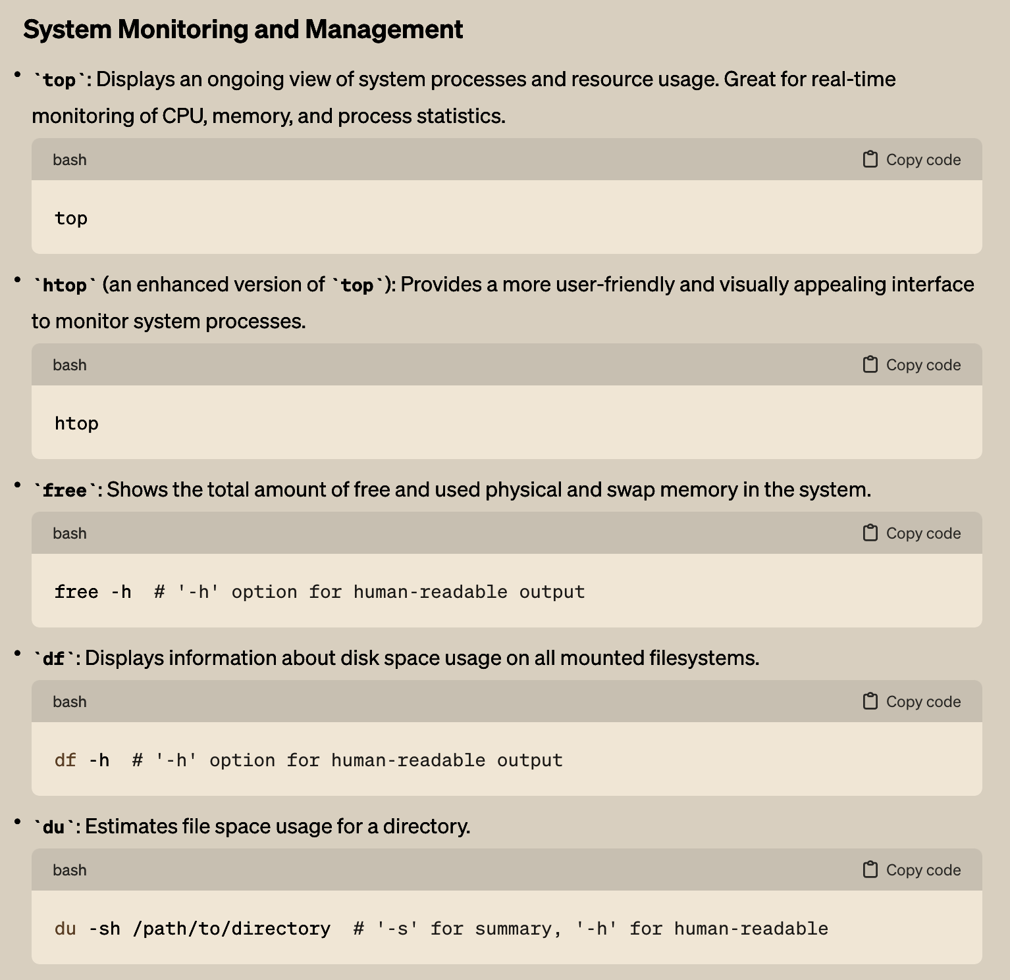
BASICS: System Monitoring and Management

Slide 33
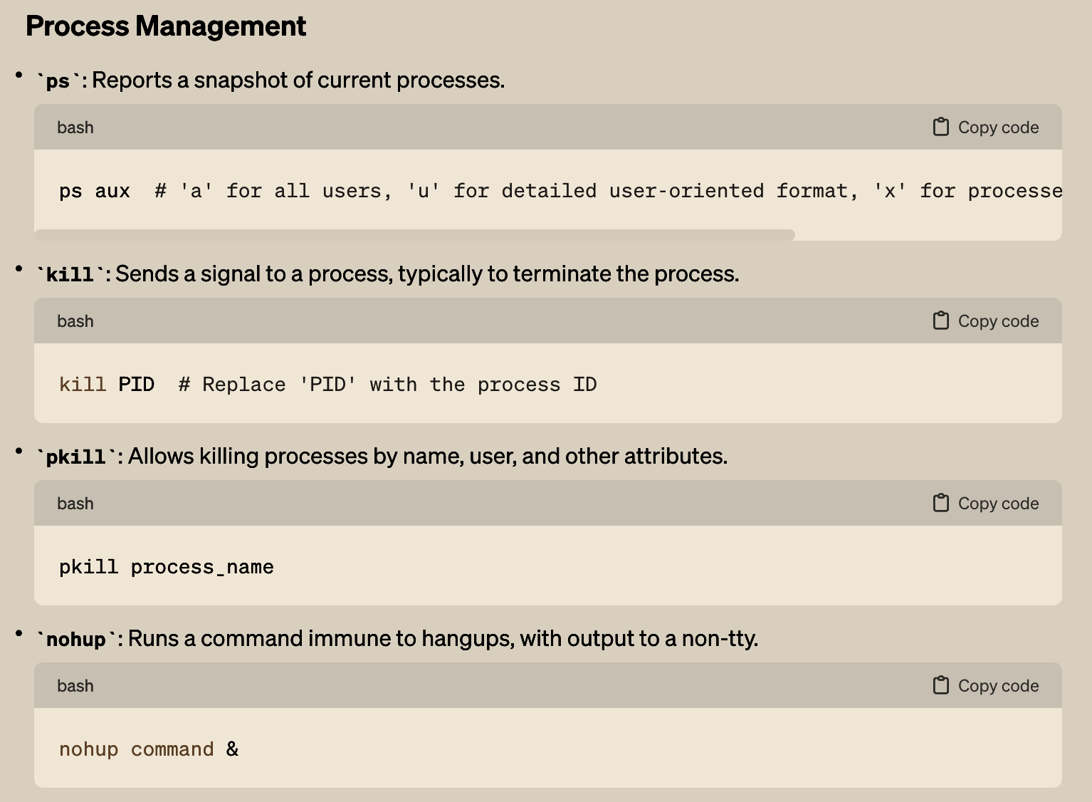
BASICS: Process Management

Slide 34
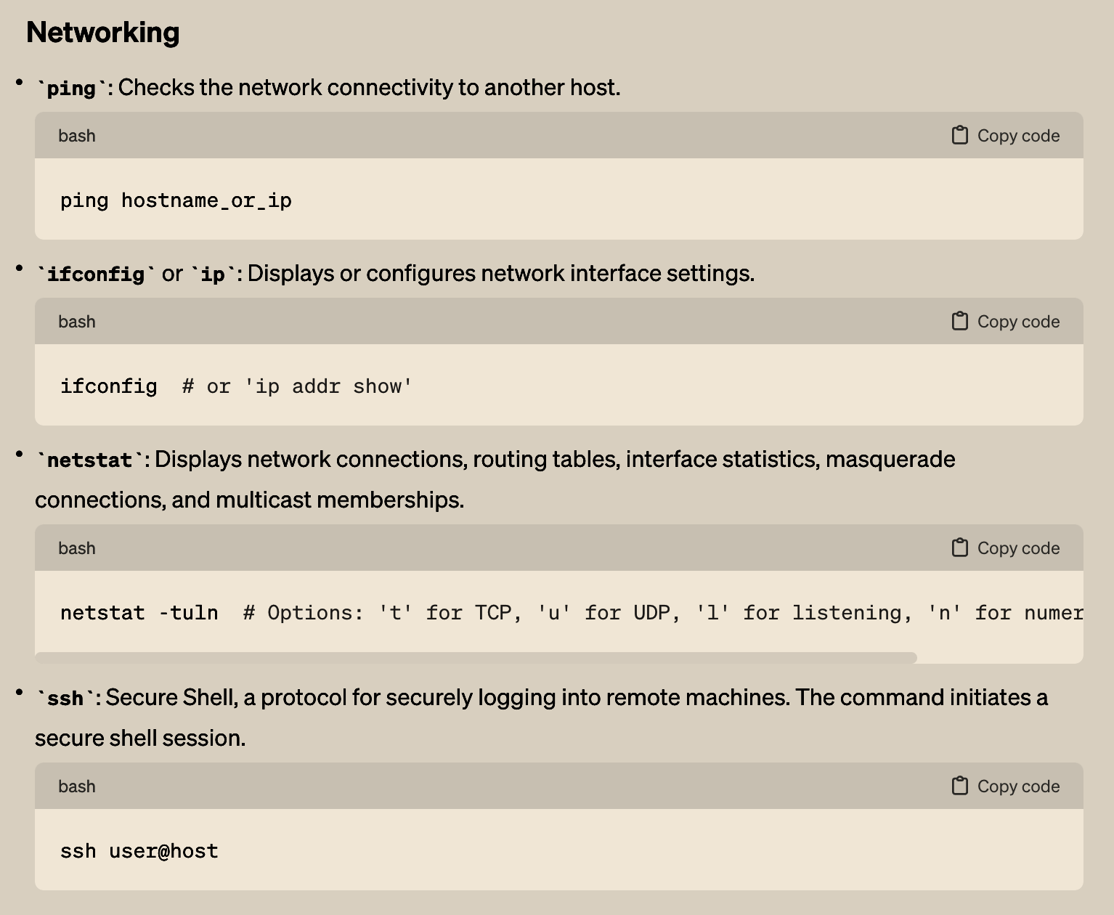
BASICS: Networking

Slide 35
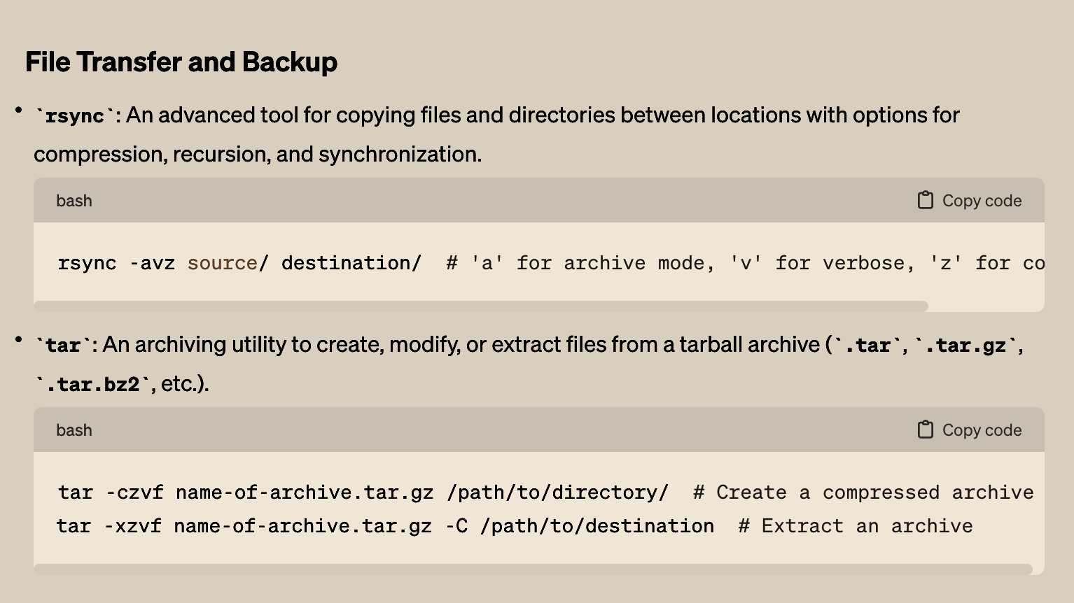
BASICS: File Transfers

Slide 36
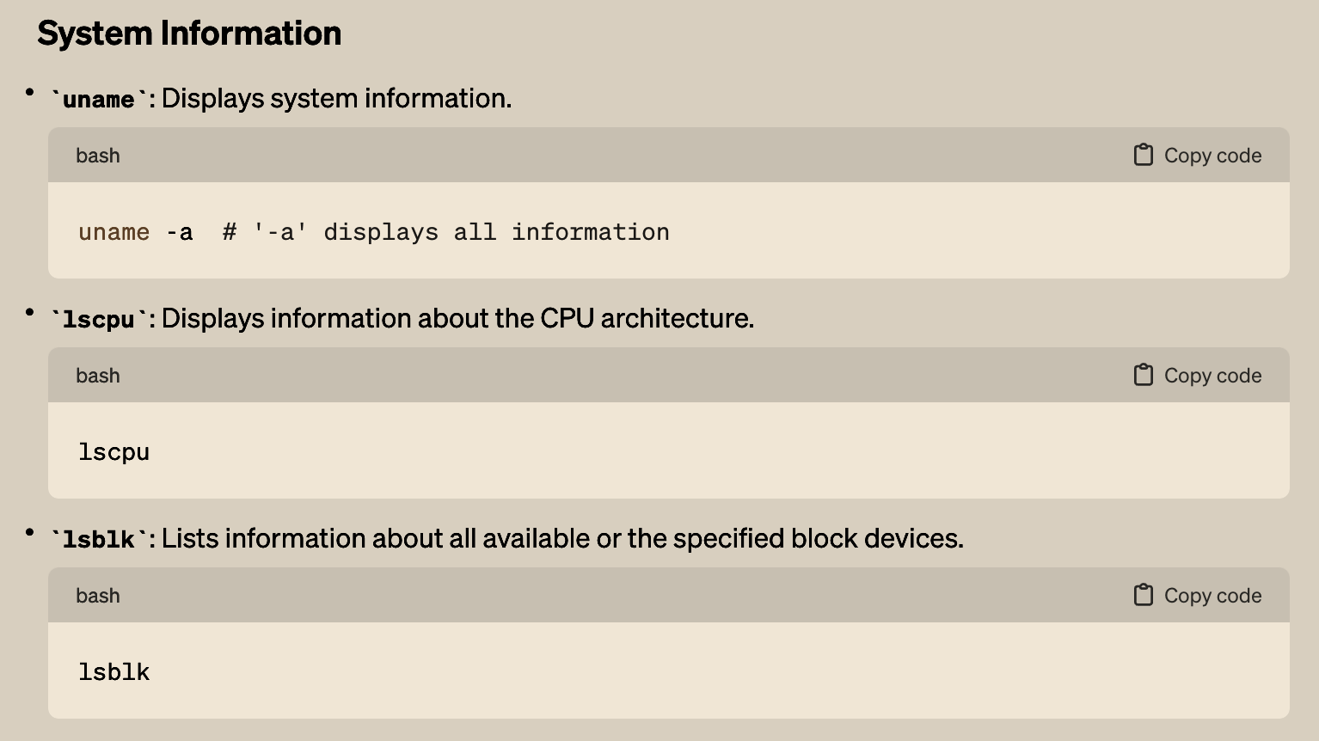
BASICS: System Information

Slide 37
BASICS: Web Service: WGET & CURL
(self explore… out of scope)

Slide 38
BASICS: Web Service: WGET & CURL
(self explore… out of scope)

Slide 39
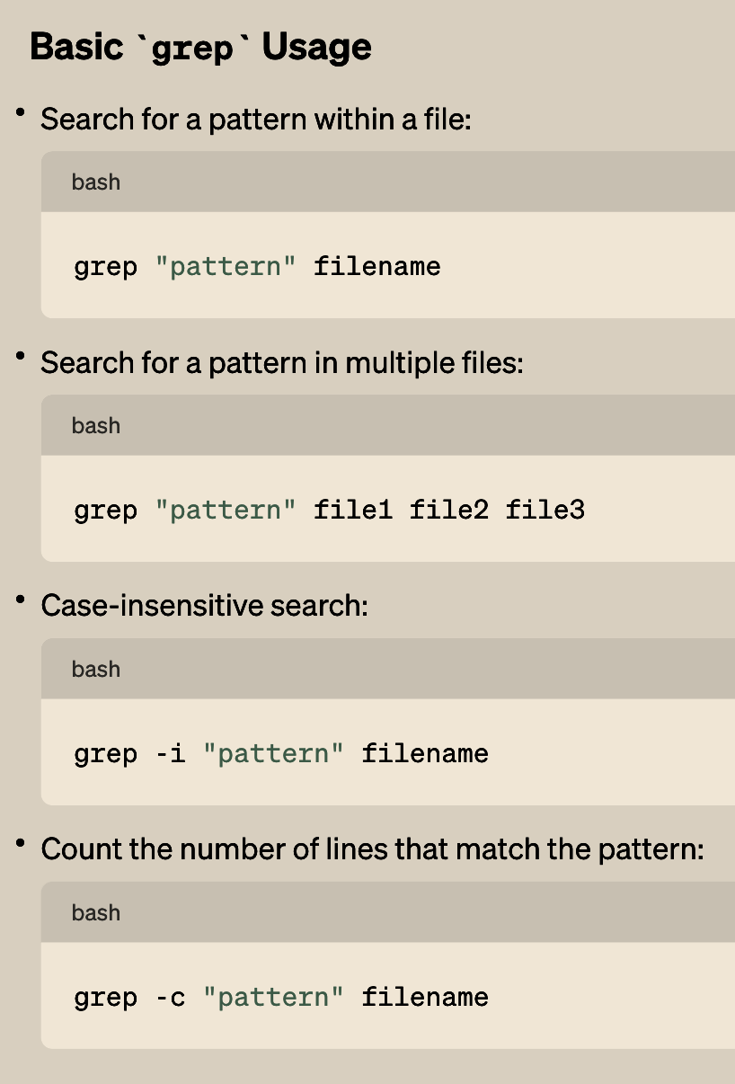
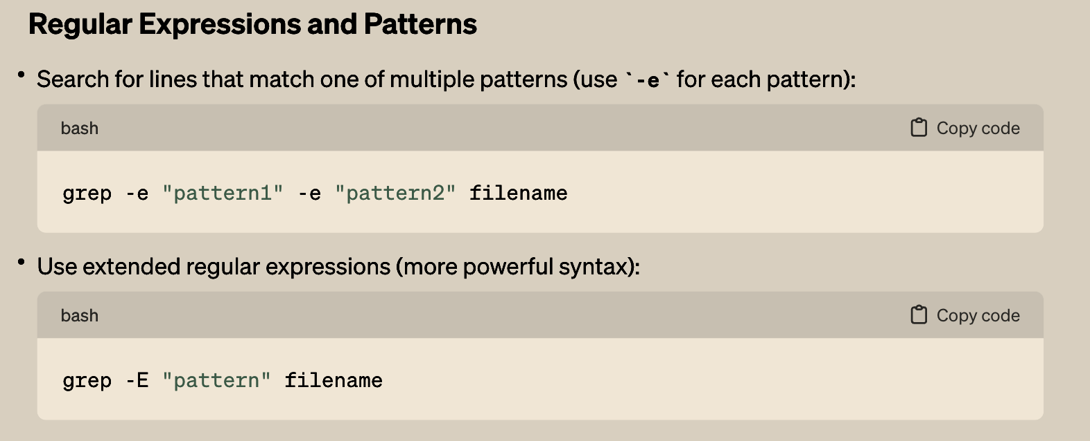
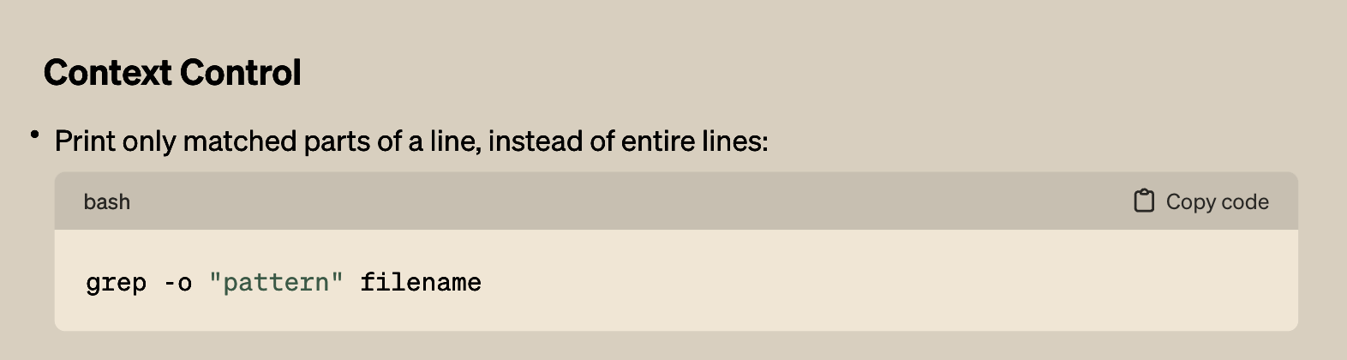
GREP: Powerful Command line utility
grep is a command-line utility in Unix and Linux used for searching plain-text data sets for lines that match a regular expression. Its name comes from the ed command g/re/p (globally search a regular expression and print). Here's a cheat sheet covering common grep usage scenarios:

Slide 40
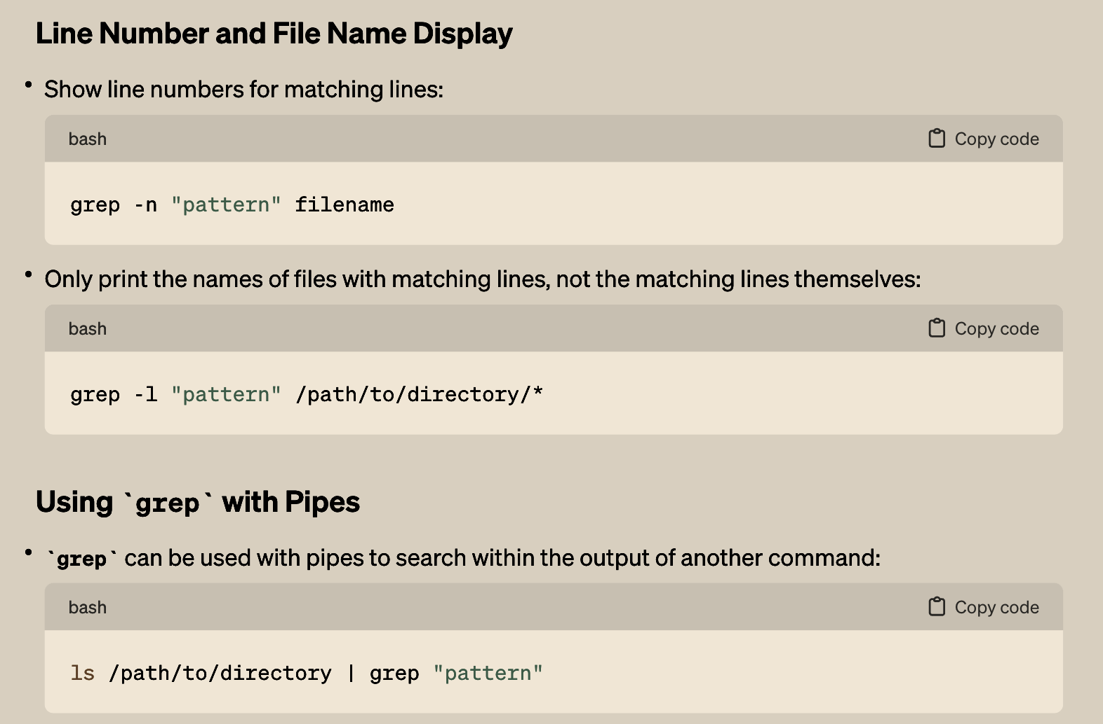
GREP: Powerful Command line utility…. more

Slide 41
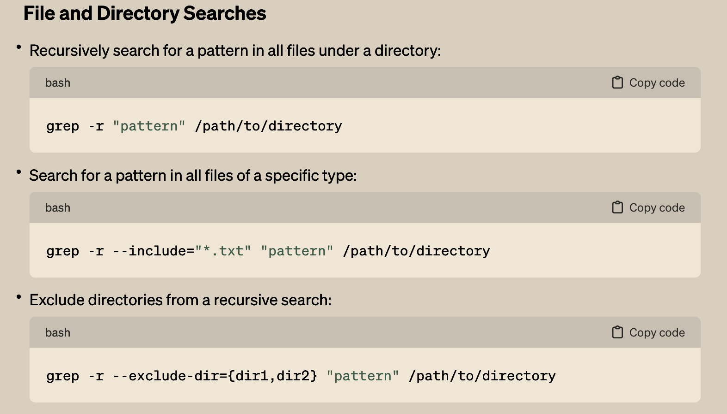
GREP: Powerful Command line utility…. more

Slide 42
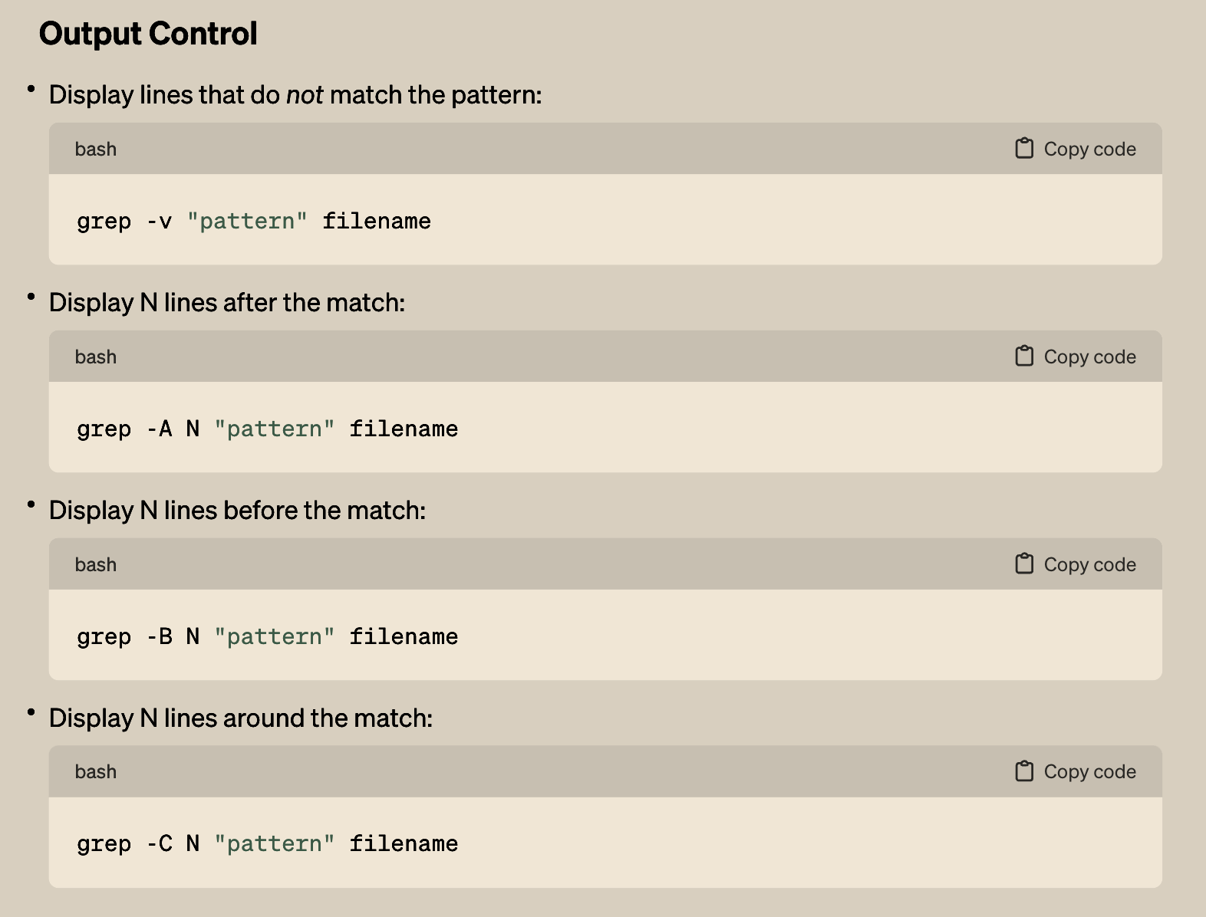
GREP: Powerful Command line utility…. more

Slide 43
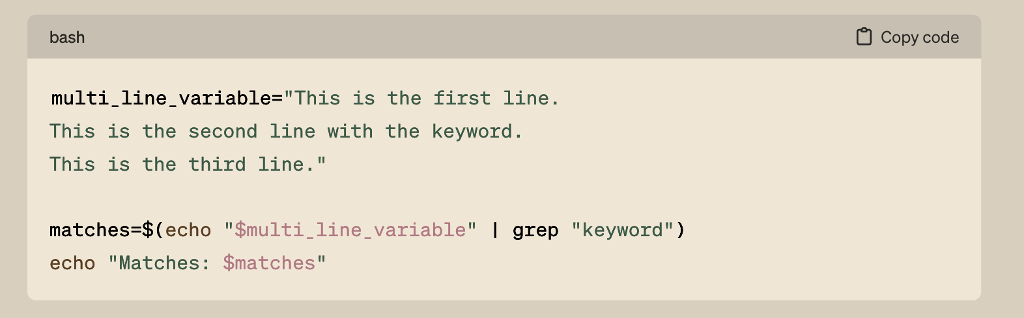
GREP: Powerful Command line utility…. more

Slide 44
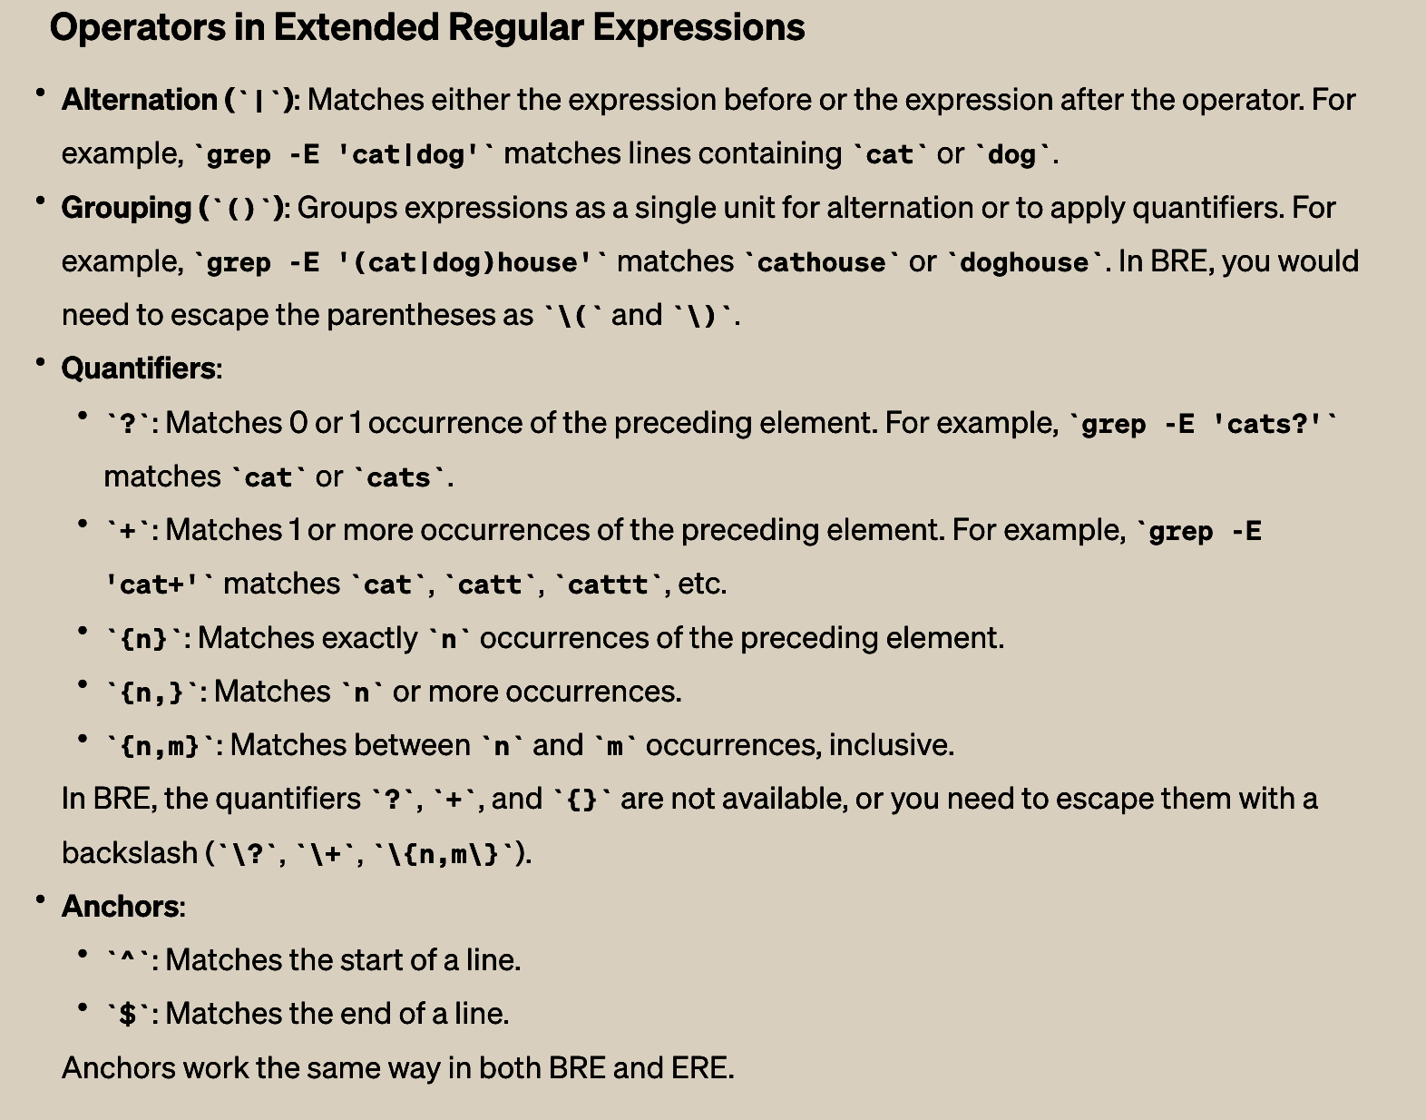
GREP: Extended Regular Expressions

Slide 45
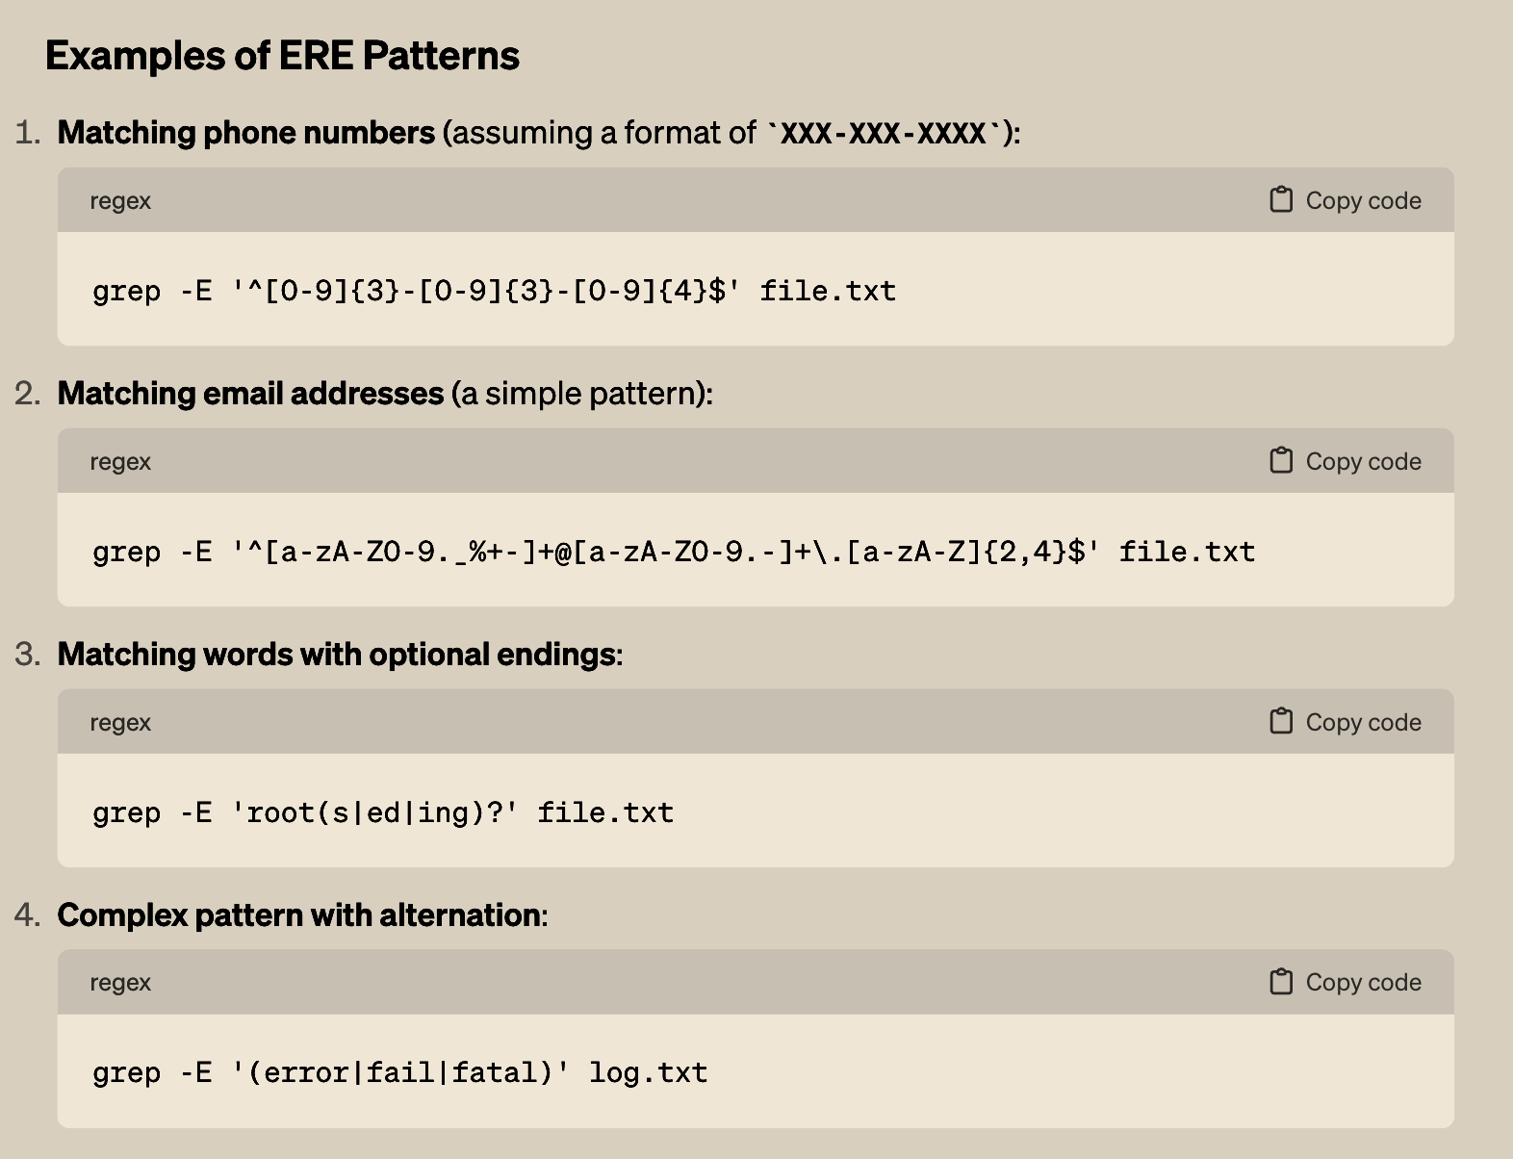
GREP: Extended Regular Expressions

Slide 46
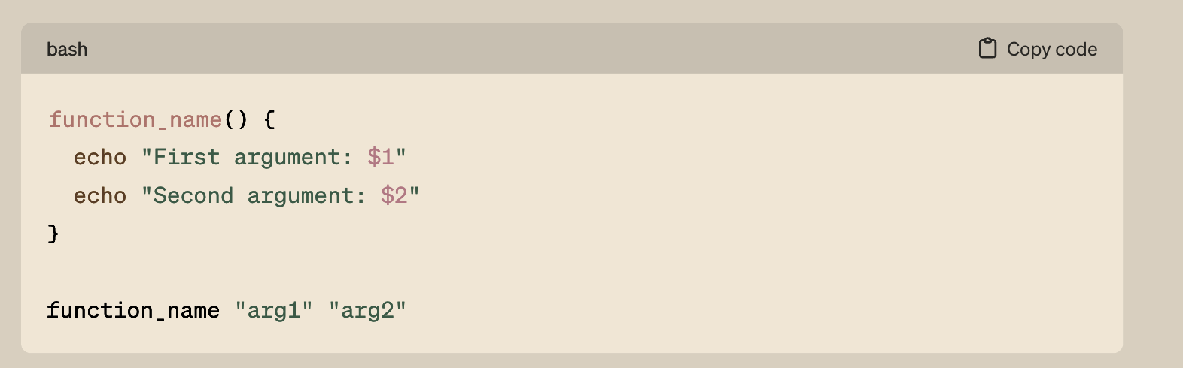
GREP: Functions

Slide 47
What next?? … awk and sed?? [LOL out of scope]

Slide 48
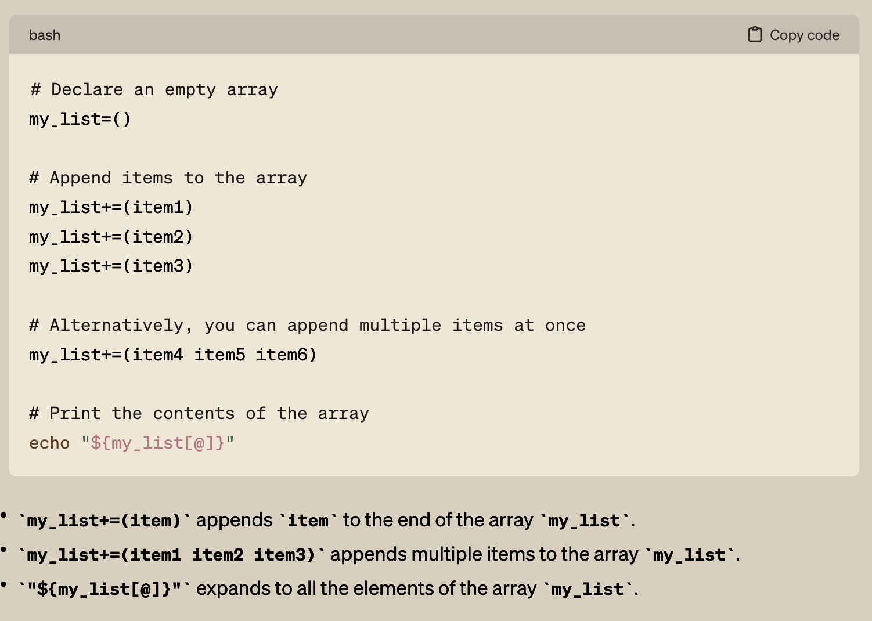
Some helpful stuff…

Slide 49

Some helpful stuff…

